Slide 1
Classifying EEG signals of affect while mimicking smile vs angry face
by using AI with LSTM networks
Hyokwon Jung, Yaeeun Kim, Youngjun Yoon, Wuon-Shik Kim
Republic of Korea Navy | CSU Sacramento | Junmeditech | KOSES
Notes:
Good morning, {Introduction}
Today I am going to present
LSTM-Based Classification of Affective EEG Signals During Facial Expression Mimicry

Slide 2

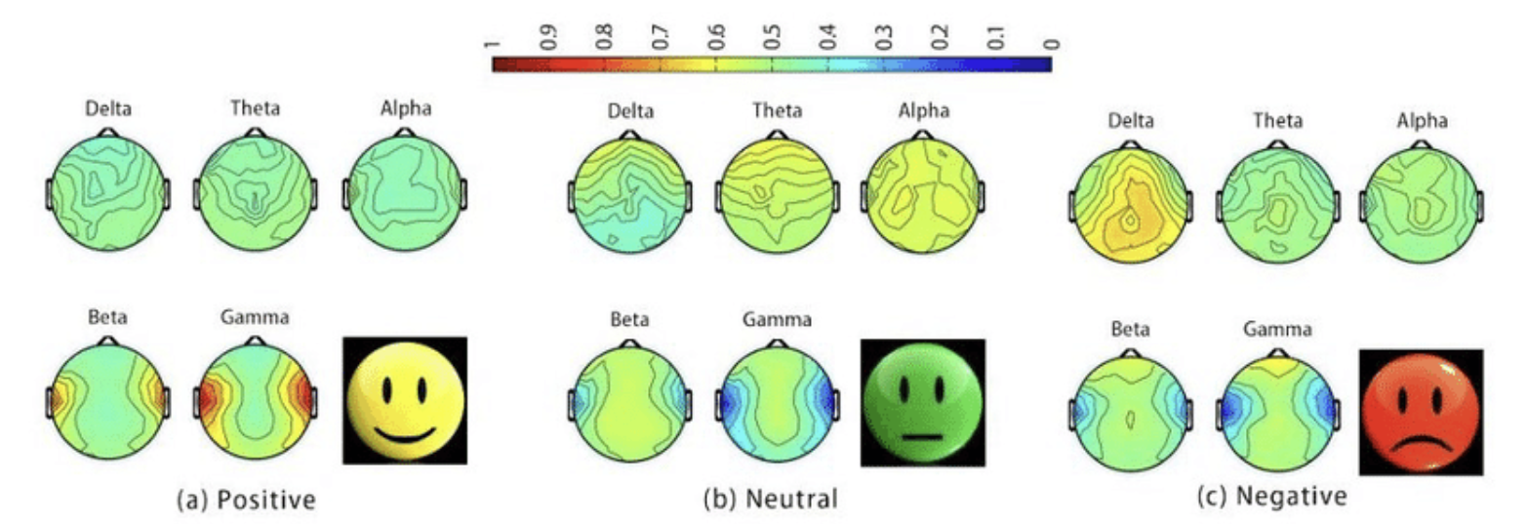
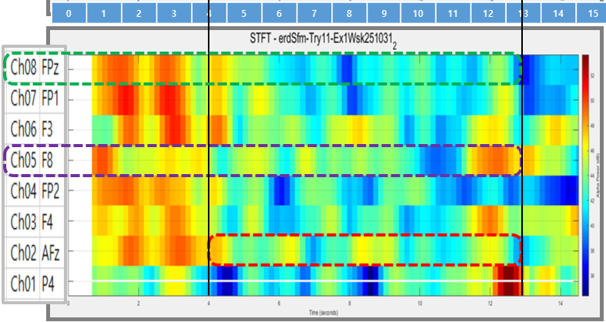
Research Summary
Goal of Research : Emotion Recognition
( Šimkovič, Vladimír & Kulifaj, Ing. (2021).)
0s
4s
13s
1/10
Notes:
The goal of this research is to recognize a subject’s emotional state using EEG signals. Although many studies have explored EEG-based emotion recognition, one major challenge remains unsolved which is the poor spatial resolution of EEG. So in this study, we shifted the perspective instead of relying on spatial resolution, we focused on EEG’s temporal resolution to classify emotional states.
In particular, we analyzed the dynamic changes in alpha power as the key indicator of emotional state. Another unique aspect of our work is that we intentionally used only two EEG channels when classifying, which means that lightweight and minimal setups can still capture meaningful emotional patterns.
Before mimicry begins (0–4 seconds), the participant is not yet imitating the facial expression, so the brain is not strongly activated. As a result, the alpha-band power remains high (shown in red).
During the 4–13 second interval, which corresponds to the facial-mimicry period, brain activation increases and alpha-band power decreases (shown in blue).
Because the presented stimulus is a smiling face, the Fpz electrode (associated with positive/pleasant affect) shows stronger blue (lower alpha power) than the F8 electrode (associated with negative/unpleasant affect).
If you ask why EEG?
Captures subconscious emotional responses
Excellent temporal resolution
Complementary to facial-expression-based emotion recognition

Slide 3
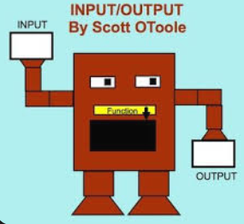

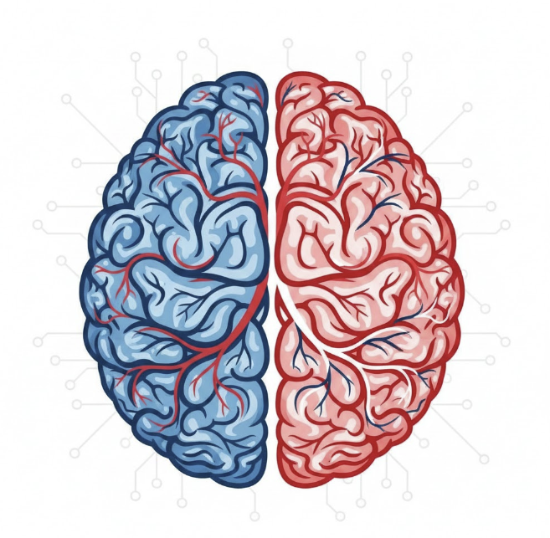

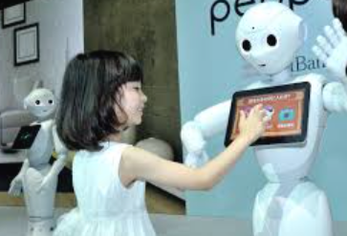


Why Emotion Recognition?
Communication
Functional Machine
Adaptive, Personalized, Emotion Aware
Decision making
Human Emotion
Interaction
2/10
Notes:
Emotions shape how we communicate, make decisions, and interact with the world. That’s why technology capable of reading human emotions can transform machines from purely functional tools into personalized, adaptive, and truly human-friendly systems.
In education, this technology can enable individualized learning experiences, strengthen engagement between virtual educators and students, and even support richer social interaction between humans and machines.
That’s why we are focusing on capturing hidden messages from the EEG signal.

Slide 4
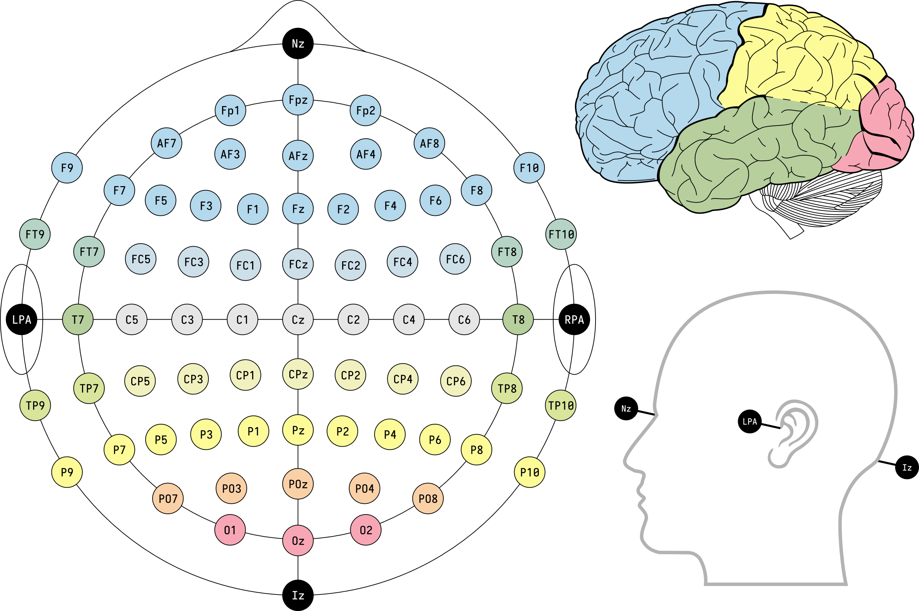
Previous Research
Grounding on Russell’s Circumplex model of affect (1980), human affect consists of affective valence and affective arousal (More Info).
Affective Valence
▪ Pleasure
-> left DLPFC (F3)*† + Fp1* + VMPFC (Fpz)†
▪ Unpleasure
-> right {DLPFC (F4)* + Fp2* + VLPFC (F8)†}
Affective Arousal
-> right PT (P4)* + DMPFC (AFz)†
10-10 System
*Heller based on EEG (1993)
†Dolcos et al. focusing on PFC based on fMRI (2004)
3/10
Notes:
“From previous research, we can identify which EEG locations are meaningful for measuring emotion. Based on Heller’s model (1993) and the fMRI findings by Dolcos and colleagues (2004), the ventromedial PFC and the left dorsolateral PFC are linked to positive affect (i.e., pleasure). In contrast, the right ventrolateral PFC is associated with negative affect (i.e., unpleasure). The dorsomedial PFC responds to both positive and negative affects, reflecting overall emotional arousal.
For anyone who isn’t familiar with brain anatomy, including me, I am gonna give you very quick introduction. The prefrontal cortex, or PFC, is the front part of the brain right behind your forehead. It’s responsible for thinking, decision-making, and emotional responses.
‘Dorsolateral’- dorso for upper and lateral for side—so it means upper side of the PFC. ‘Ventromedial’- ventro for bottom and medial for middle—so the ventromedial area is the lower middle part of the PFC.
‘Ventrolateral’ - ventro for bottom and lateral for side—so the ventrolateral is the lower side of the PFC.

Slide 5
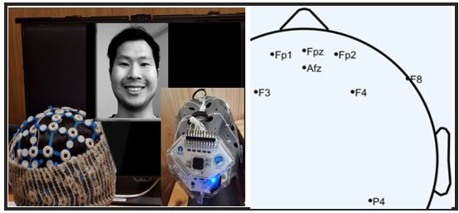
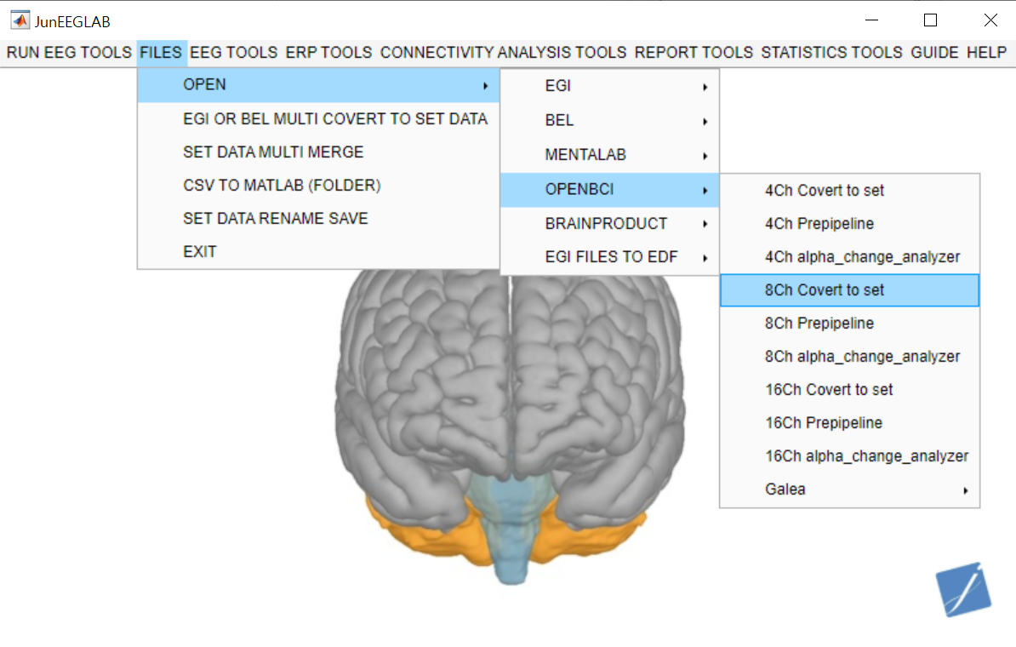
Experiment Set up
▪ 8 Electrodes Selected
* F3, FP1, FPz, AFz, FP2, F4, F8, P4
▪ Facial Mimicry Test
▪ Customized OpenBCI *
* JunEEGLAB Program reduce noises in EEG signal(eye blink, facial movement etc.)
*JunEEGLAB
4/10
Notes:
Based on previous research, we selected eight EEG electrode locations. However, for this study we used only two of them to keep the model lightweight and practical for future applications. After the setup was completed, participants were shown images of smiling or angry faces and asked to mimic those expressions. The EEG signals generated during this mimicry were recorded and preprocessed using a customized OpenBCI system (JunEEGLAB) developed by Junmeditech.
수정 예정

Slide 6
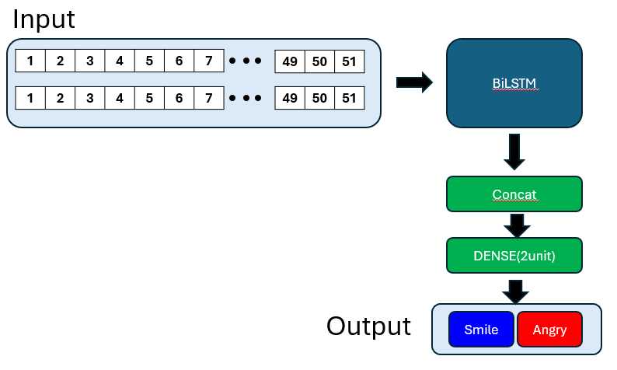
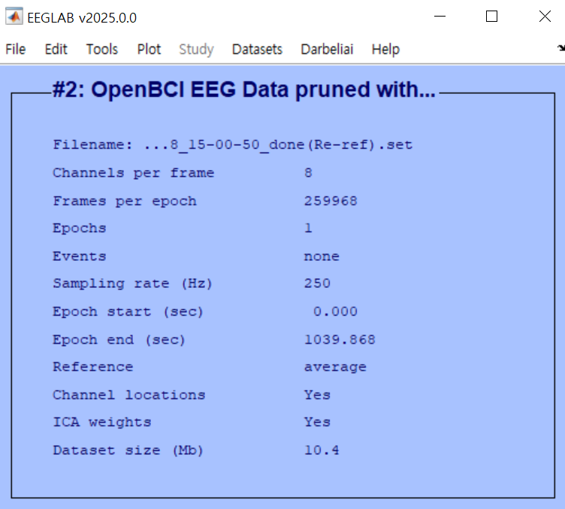
Experiment Design
▪ Flow of Experiment
Step 1
Step 2
Step 3
Data Collection
Preprocessing
Train/Test AI Model
Facial Mimicry
Noise Reduction
Feature Extraction
(STFT)
BiLSTM
* 12 Participants
5/10
Notes:
We divided the process into three main steps.
Step 1 is Data Collection. Step 2 is Preprocessing. Step 3 is Training and Testing the AI Model. We fed the preprocessed EEG sequences into a BiLSTM network. This model learns temporal patterns in the alpha power and classifies each trial as either ‘smile’ or ‘anger’.

Slide 7
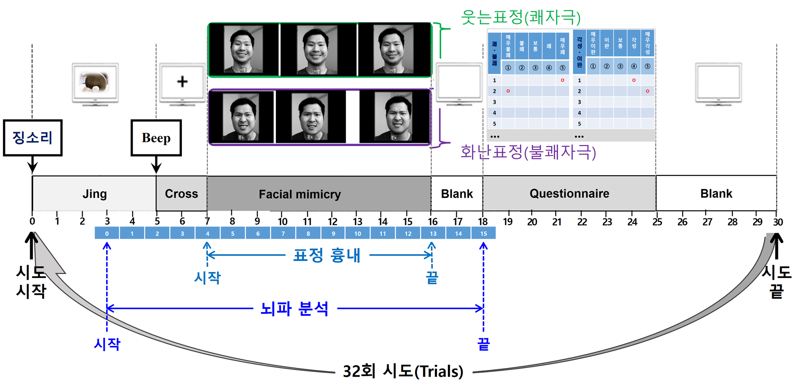
Experiment
▪ Step 1. Data Collection
Recorded for 9 S at 250 Hz
→ 2250 Samples
6/10
Notes:
Participants were shown images of smiling or angry faces and asked to mimic those expressions. While they mimicked the expressions, we recorded their brain activity using our EEG system.
Initially, we planned to collect a large amount of data by having each participant complete 30 trials. However, due to the poor laboratory environment, most of the recordings were contaminated with noise. As a result, for this conference we were only able to use 12 usable smile trials and 8 angry trials.
Because of this very small dataset, we needed a reasonable way to still obtain meaningful results. So we applied data augmentation to make the most of the limited data. I will explain the details later in the presentation.
Each trial contained 9 second EEG data recorded at 250 Hz, generating 2,250 samples.

Slide 8
Experiment
▪ Step 2. Pre-processing (Feature Extraction)
9 second(2250 Samples)
Noise reduction via independent component analysis method in JunEEGLAB Program
2) The raw EEG data were filtered to extract the alpha band (8-13 Hz)
3) STFT with 1.5-s window, 90% overlap
51 frames
7/10
Notes:
1) The raw EEG signals contain noise from blinking and facial movement, so we first applied noise reduction with JunEEGLAB.
2) Then we extracted alpha-band signal
3) and via Short-Time Fourier Transform with 1.5 sec window and 90% overlap we could get 51 frames for 9-s EEG from each trial.
In short, 9-s signal transformed to 51 frames. Let see what it means in next page. (click link)
(필요시)
We used a 1.5-second STFT window because it includes about ten cycles of the lowest alpha frequency, 8 Hz. You need multiple cycles to measure a frequency accurately, so 1.5 seconds gives a stable estimate of alpha-band power. 8 Hz means that 1/8 seconds(0.125 s) for one cycle of signal, so almost 10 times (1.25 sec) is enough to contain lowest frequency.

Slide 9
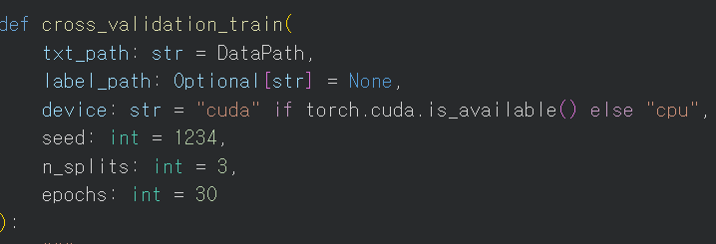

Experiment
▪ Step 3. Train and Test AI Model
BiLSTM
1 hidden layer
100 units
Smile
F8
1 | 2 | 3 | 4 | 5 | 6 | 7
49 | 50 | 51
FPz
1 | 2 | 3 | 4 | 5 | 6 | 7
49 | 50 | 51
Angry
▪ Actions taken to reinforce a limited dataset
1) Data augmentation
2) K-fold Validation
8/10
Notes:
As you saw before, the input data was two channels with 51 blocks passing through single layer BiLSTM with 100 hidden Units.
You might think that 100 hidden units might make overfitting. We partially agree with your opinion.
Because our dataset was extremely small, we applied data augmentation to help the model generalize better. During training, each EEG sequence had a 70% chance of being augmented. When augmentation was triggered, the model randomly applied one of several transformations - or a combination of them.
These included adding Gaussian noise, scaling the amplitude of the signal, shifting the sequence slightly in time, or mixing these effects together. This process artificially increases the variability of the data, allowing the BiLSTM to learn more robust temporal patterns instead of memorizing the limited original trials.
Importantly, augmentation was applied only during training, never during validation or testing. This ensures the model is evaluated strictly on the real, unmodified EEG signals
Also we used 3-fold cross-validation to get a more reliable result with our small dataset. The data was split into three parts, and each part took turns serving as the validation set while the others were used for training.
We then averaged the performance across all three folds, giving us a more stable and trustworthy accuracy.

Slide 10
Result / Limitation and future work
▪ Result : Affect classified by AI
* Accuracy of 70.63% ± 10.71%
▪ Limitations
▪ Future Work
1) Lack of Data
1) Train AI with large dataset
2) Maybe not the best electrode location
2) Seek better location for measure
9/10
Notes:
The average accuracy is 70.63%, and the standard deviation of ±10.71% indicates moderate variability.
Despite the limited number of samples, the model demonstrates stable and meaningful classification performance.
However, our study has several important limitations. First, the dataset was extremely small due to noise and contamination in many of the recordings. This small sample size increases variability and makes it difficult for the model to fully generalize.
Second, the experiment involved a few participants, meaning the model learned person-specific patterns rather than universal features.
For real-world applications, a larger and more diverse participant pool is required.
For future work,
Most important thing is getting large dataset.
And seek better location for measure EEG.
we used two frontal electrodes, Fpz and F8, based on previous findings.
However, these positions may also be influenced by neighboring brain activity and other sources of noise, so they are not guaranteed to be the optimal locations for measuring emotional responses.
As future work, we need to record from a broader set of electrodes in a pilot experiment, broader channel selection will allow us to identify the most informative electrode positions for emotion recognition. Ultimately, this approach will help us move from “theoretically reasonable” electrode choices to empirically optimized sensor locations for future experiments and real-world applications.

Slide 11


Questions ?
10/10

Slide 12
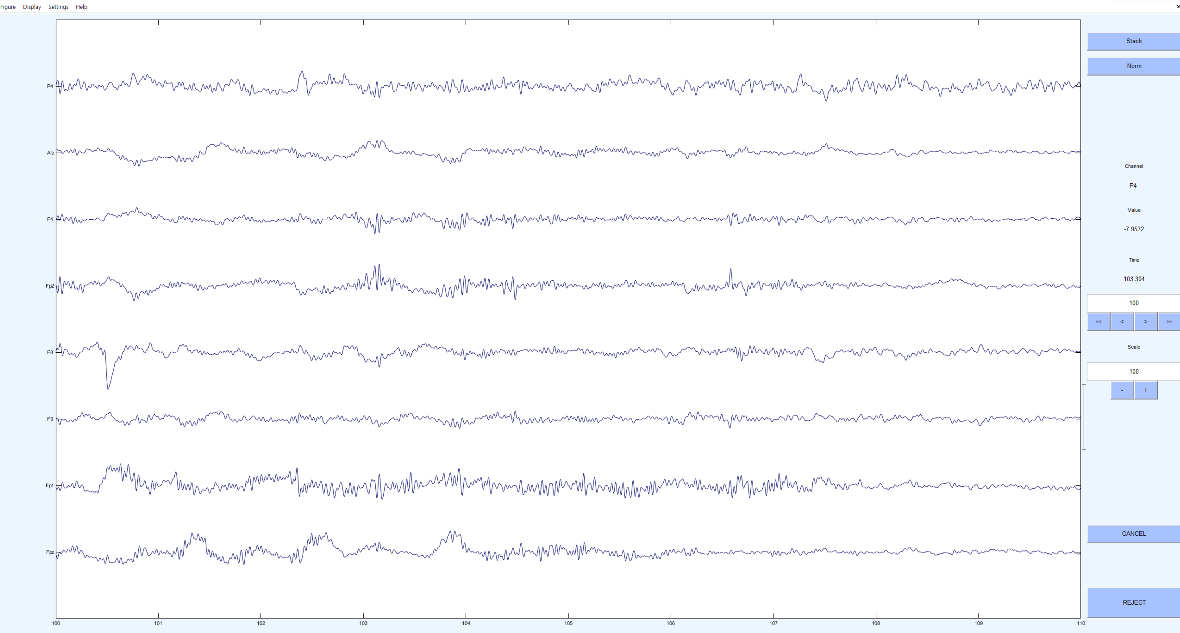
Quick Explanation
3) STFT with 1.5-s window, 90% overlap
51 frames
F8
FPz
0
1
2
3
4
5
6
7
8
9

Slide 13
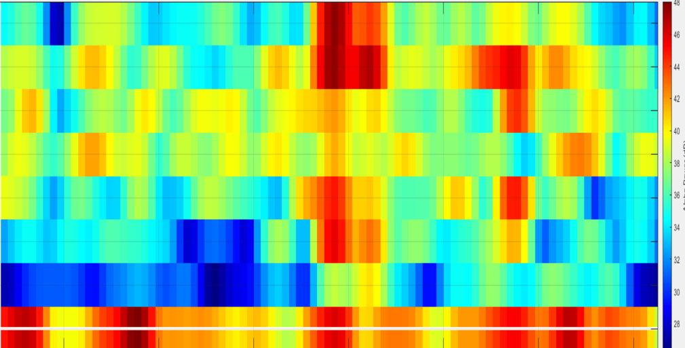
Quick Explanation
3) STFT with 1.5-s window, 90% overlap
51 frames
F8
FPz
0
1
2
3
4
5
6
7
8
9
STFT
FPz
←Back
F8

Slide 14
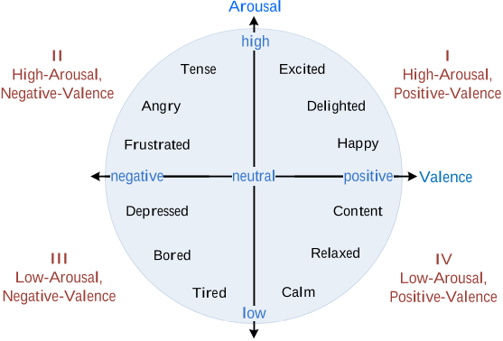
Core emotions established in the Russell’s Circumplex Model.

Slide 15
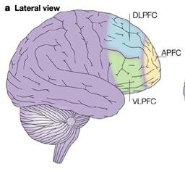
The prefrontal cortex (PFC) can be divided into anterior (APFC, Brodmann area (BA) 10), dorsolateral (DLPFC, BA 46 and 9), ventrolateral (VLPFC, BA 44, 45 and 47) and medial (MPFC, BA 25 and 32) regions. BAs 11, 12 and 14 are commonly referred to as orbitofrontal cortex. (Adapted from Simons and Spiers, 2003, Nature Neuroscience).
←Back

Slide 16
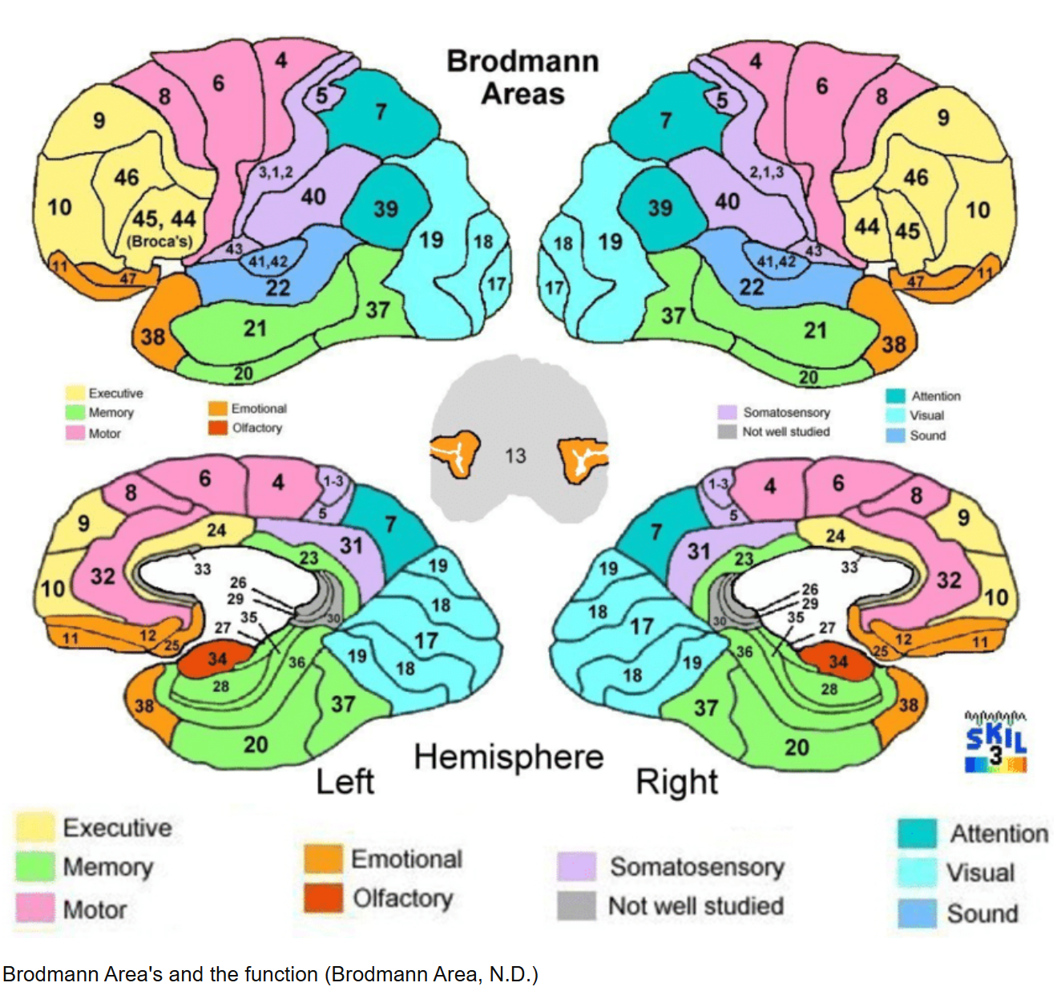

Slide 17
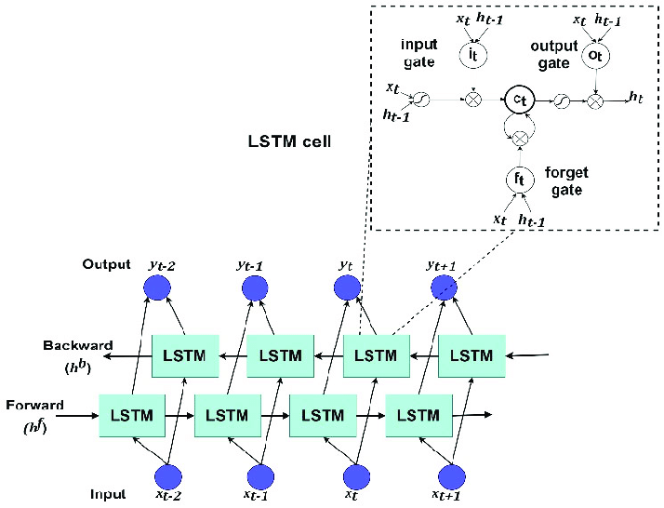
Single Layer Bidirectional LSTM
▪ Hyperparameters for LSTM used in this research
- Input Layer : (51,2) tensor
- Num_Hidden layer : 1
- Num_Hidden Units : 100
- Drop out rate : 30%
- Optimizer : Adam
→ model to consider both past and future contexts simultaneously
←Back

Slide 18
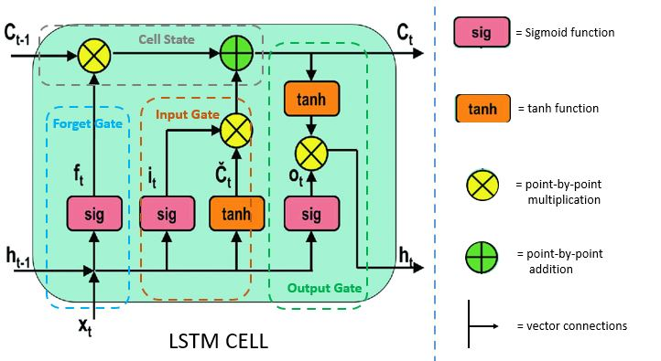
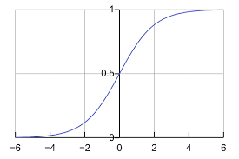
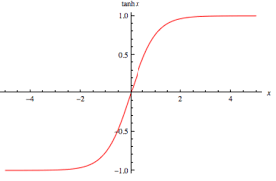
LSTM(Long Short Term Memory) Explained
▪ LSTM is a kind of neural network that is very good at
understanding sequences
Forget Gate — "Should I forget this?"
Input Gate — "Should I remember this
new information?"
Output Gate — "What should I output?"
←Back

Slide 19
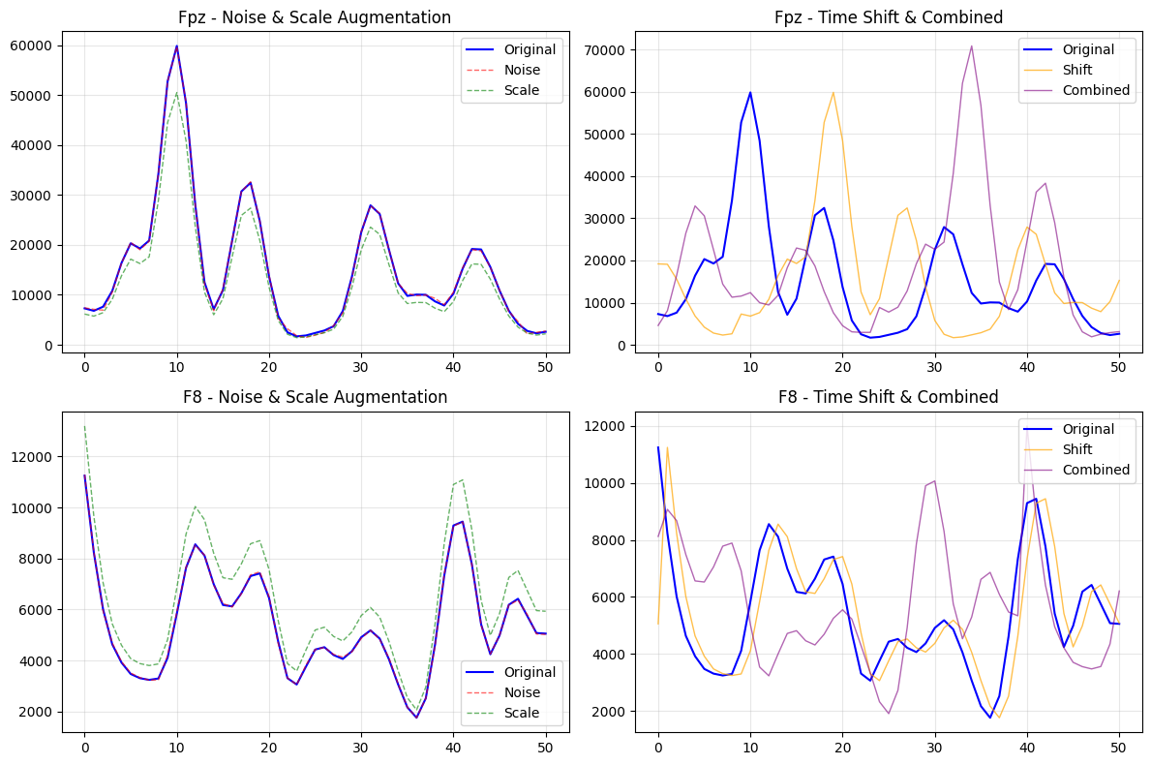
Data Augumentation Example
←Back

Slide 20
3-Fold Stratified Cross-Validation
▪Dataset :
Dataset
Fold 1
Fold 2
Fold 3
Train
Validate
Fold 1
Fold 2
Fold 3
Fold 2
Fold 3
Fold 1
Fold 3
Fold 1
Fold 2
←Back

